Slide 1
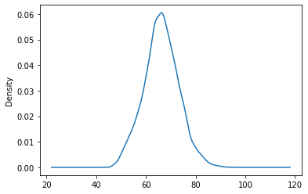
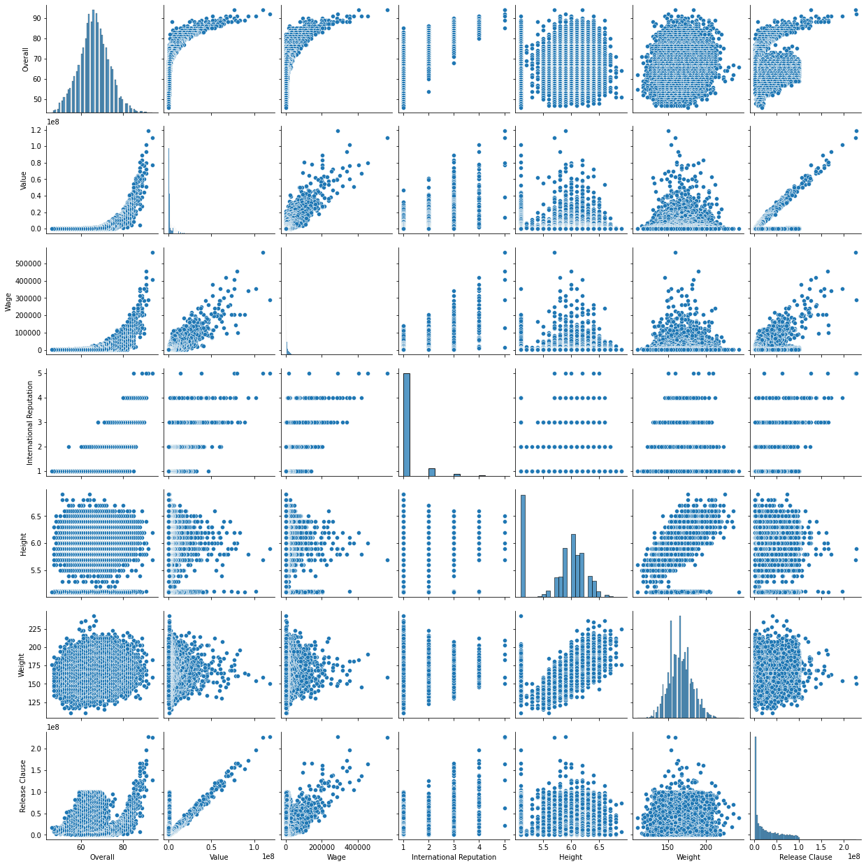
Distribution for the Overall ratings
Pairplots - Overall, Value, Wage, International Reputation, Height, Weight, Release Clause

Slide 2
Top 20 players ranked by Overall score and whose contract expires in 2020
Average Wage | Average age
205450 | 25

Slide 3
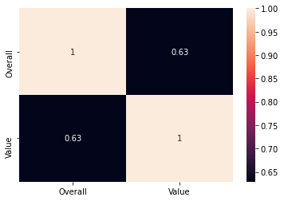
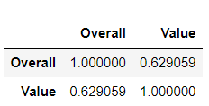
Correlation between the Overall rating and Value for these players

Slide 4
The average wage one can expect to pay for the top 5 in every position
POSITION | Expected Average Wage
ST | 294000.0
GK | 192800.0
CB | 124800.0
CM | 124800.0
LB | 177200.0
RB | 155400.0
RM | 123400.0
POSITION | Expected Average Wage
LM | 152600.0
CAM | 174000.0
CDM | 199200.0
RCB | 219000.0
LCB | 162000.0
RCM | 252200.0
LCM | 203000.0
POSITION | Expected Average Wage
LW | 261000.0
RW | 202000.0
RDM | 105000.0
LDM | 92400.0
LS | 92200.0
RS | 130400.0
RWB | 44200.0
POSITION | Expected Average Wage
LWB | 30000.0
CF | 47400.0
RAM | 46600.0
LAM | 21800.0
LF | 123200.0
RF | 148000.0

